Slide 1
Applied Data Science Machine Learning in Python
Dr. Omri Allouche
2017

Slide 2
Homework
Read https://www.oreilly.com/ideas/intro-to-scikit-learn
Read http://amueller.github.io/sklearn_tutorial/
Watch https://github.com/justmarkham/scikit-learn-videos

Slide 3
SciKit Learn
Most popular ML library on Python
Many algorithms
Clean & uniform API
Features matrix – rows are observations, columns are features
Target array
Consistent structure, uses an estimator object with methods fit, predict, score
Sensible defaults for each algorithm

Slide 4
SKLEARN Workflow
Choose a class of model by importing the appropriate estimator class from Scikit-Learn.
Choose model hyperparameters by instantiating this class with desired values.
Arrange data into a features matrix and target vector following the discussion above.
Fit the model to your data by calling the fit() method of the model instance.
Apply the Model to new data:
For supervised learning, often we predict labels for unknown data using the predict() method.
For unsupervised learning, we often transform or infer properties of the data using the transform() or predict() method.

Slide 5

Choosing an Algorithm

Slide 6
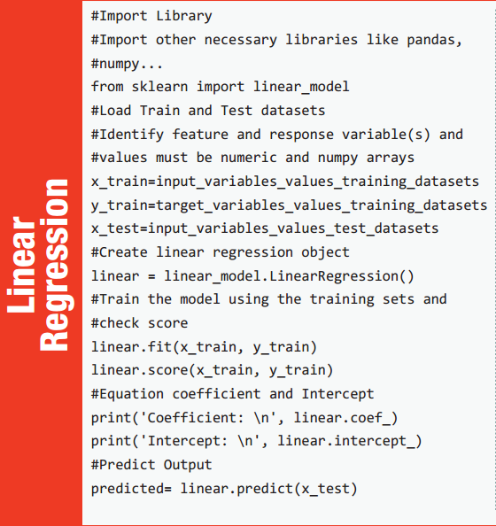
Notes:
https://www.analyticsvidhya.com/wp-content/uploads/2016/08/MLalgorithms-.pdf

Slide 7
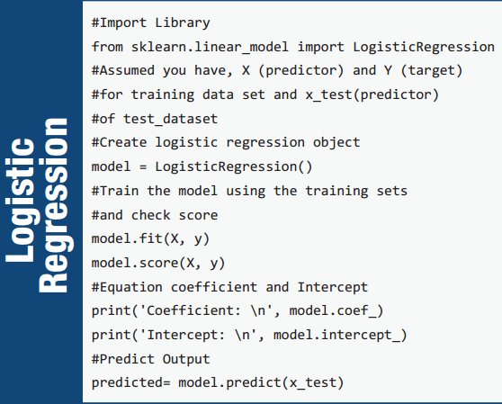

Slide 8
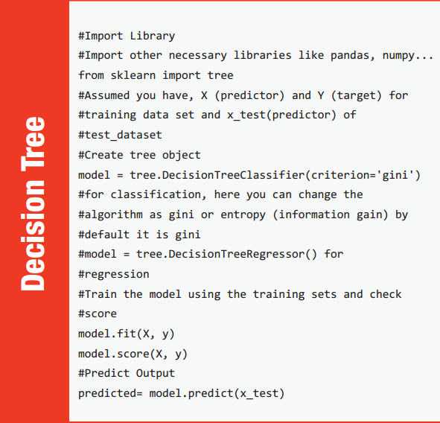

Slide 9
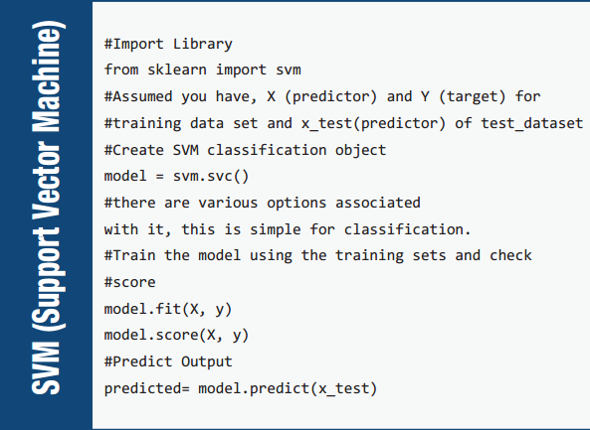

Slide 10
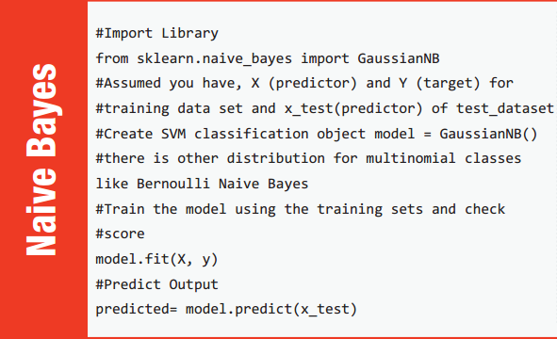

Slide 11
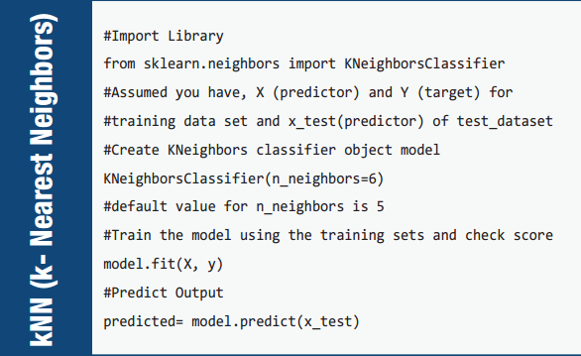

Slide 12
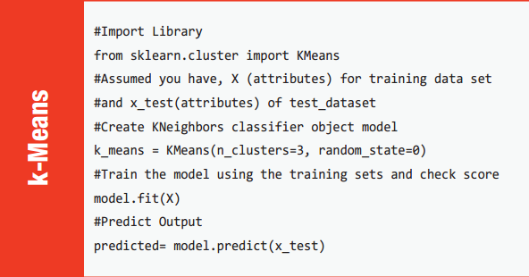

Slide 13
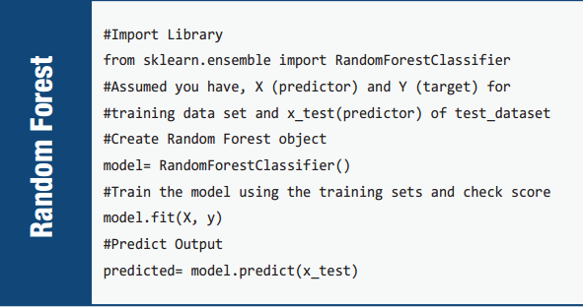

Slide 14
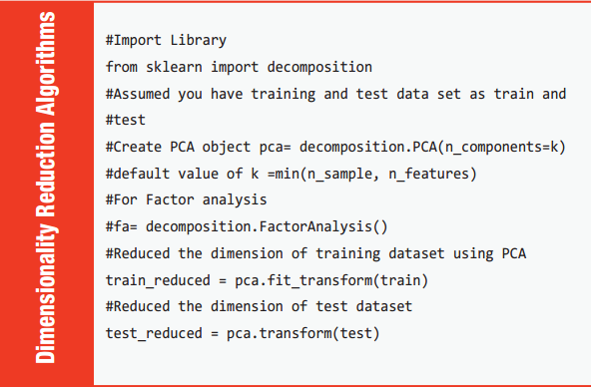

Slide 15
Successful Learning
Factors important for a successful learning:
Enough examples
Examples represent population
Model is powerful enough
Model isn’t “too powerful”

Slide 16
Regression Evaluation Measures
callable string function
mean_absolute_error sklearn.metrics.mean_absolute_error
mean_squared_error sklearn.metrics.mean_squared_error
r2 sklearn.metrics.r2_score

Slide 17
Classification Evaluation Measures
callable string function
accuracy sklearn.metrics.accuracy_score
precision sklearn.metrics.precision_score
recall sklearn.metrics.recall_score
f1 sklearn.metrics.f1_score
roc_auc sklearn.metrics.roc_auc_score

Slide 18
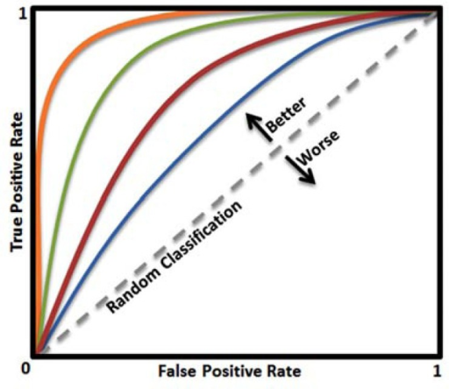
ROC – Receiver Operating Curve

Slide 19
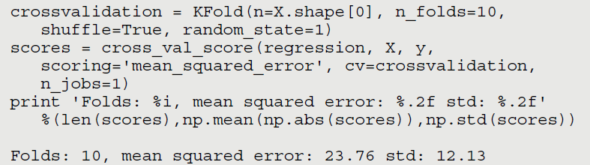
Cross Validation – k-fold

Slide 20
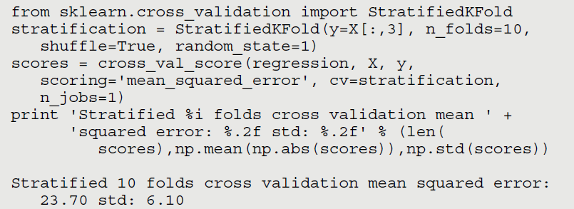
Sampling Stratification
Consider distribution when sampling, to prevent malformed samples

